Slide 1
Face Detection on the GPU
Phil Monroe and Kramer Straube
EEC 277 Final Project
University of California, Davis

Slide 2
Viola-Jones Object Detection
Idea: Use simple rectangular classifiers to rule out things that aren’t faces until you end up with only things that are faces.

Slide 3
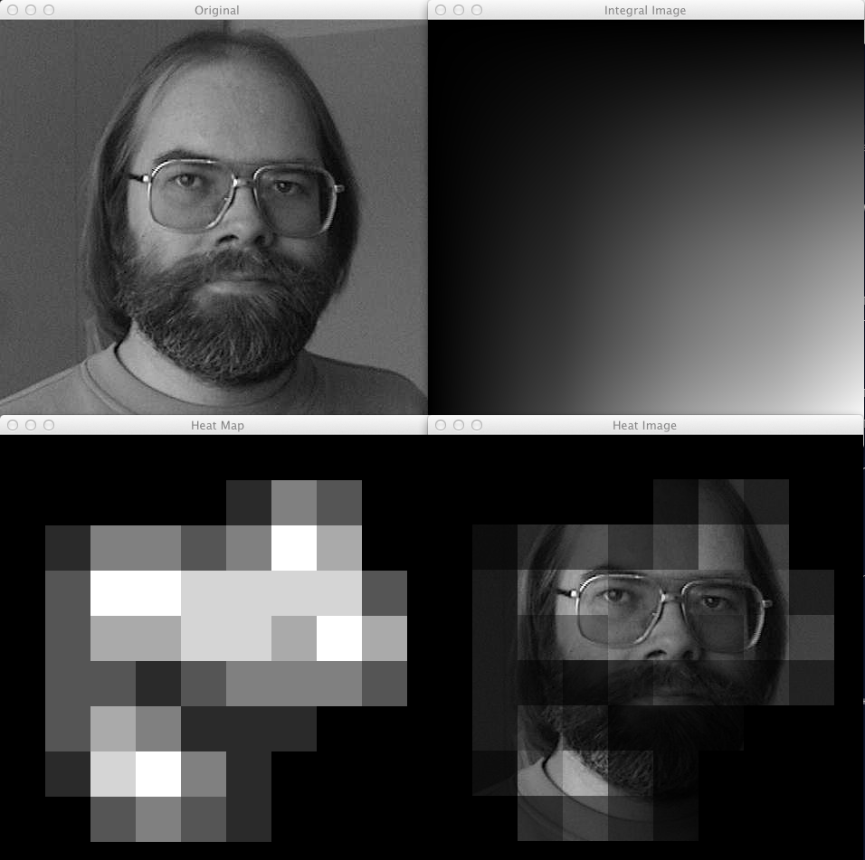
Integral Images
Integral images reduce memory lookups of classifiers
Pre-compute areas by summing all pixels above and left of the given pixel

Slide 4
Classifiers
Simple rectangular classifiers
Fit value = white area – black area
Find fit value at many different image locations

Slide 5
Cascading Classifiers
Have each classifier remove all of the failures from the input data for the next classifier
Anything left at the end is a face
Pass
Sub-windows
Classifier 1
Classifier 2
Pass
Fail
Fail
Not a face
Is a face!

Slide 6
Glasses Classifier
One extra classifier to determine whether the faces detected have glasses on or not
Overly simple but just a small extension of the algorithm

Slide 7
Opportunities for Parallelism
Different scales
Evaluate identifier at different sizes
Different subwindows
Many different subwindows per image at different offsets and different scales
Different identifiers
We only use a single identifier per stage and cascade them so this one cannot be used in our implementation

Slide 8
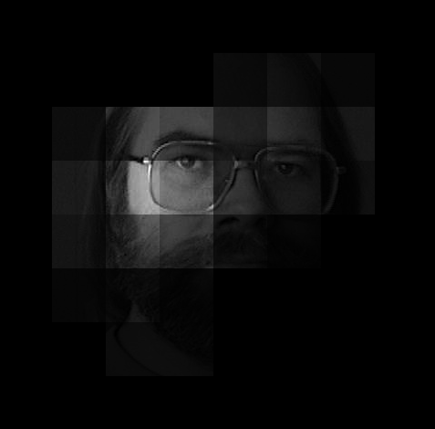
Results
Execution times:
Face detection – 0.20334 s
Glasses detection (after face detection) – 0.004104 s

Slide 9
Lessons Learned
Integral images on GPU vs. CPU
Occupancy based on scale
Issues with memory coalescing
Cascade versus non-cascade on GPU

Slide 10
Computing Integral Images
Parallel approach (GPU):
compute all pixels above (column scan)
then add the column scan values of each location to the left (row scan)
Serial approach (CPU):
Just iterate through from top left down to bottom right and add the neighbors
Results: CPU wins (0.000709s vs. 0.005148s)

Slide 11
Occupancy Based on Scale
Different scales of identifiers equals more concurrent threads that can be run
Each thread only using ~10 registers so no local memory issues
Optimal thread count (based on CUDA calculator): 128 threads per block

Slide 12
Memory Coalescing
Classifier memory accesses are not regular
Each classifier skips several pixels as it is scanned across the image
Issue: How to make these sparse but predictable memory accesses coalesce?

Slide 13
Cascade versus Non-Cascade
On CPU, cascading removes a ton of work and is a net win
On GPU, parallel units can do the extra work that makes cascading lose some of its advantage
Removing the bad sub-windows also takes GPU time (scan)

Slide 14

Questions

